Slide 1


FACULTY OF ENGINERRING AND TECHNOLOGY
CEF 440: INTERNET AND MOBILE PROGRAMMING
TASK 6
DATABASE DESIGN AND IMPLEMENTATION
PRESENTED BY: GROUP 9

Slide 2


TABLE OF CONTENTS
Introduction
Conceptual design
Implementation
Conclusion

Slide 3
INTRODUCTION
OBJECTIVES
Conceptual design
Entity relationship diagram explanation
Visual representation
Implementation
Supabase tools and how it works
Supabase as a backend as a service
Integrity constraints

Slide 4
CONCEPTUAL DESIGN
A. Entity Relational Diagram (ER Diagram)
An Entity-Relationship Diagram (ERD) is a visual representation of the entities, attributes, and relationships within a database system. ERDs help database designers and developers understand the data requirements and relationships in a clear and concise manner.
Entity and attributes
Relationships
Keys (Primary and foreign keys)

Slide 5
B. Visual representation
The layout of the wireframe is such a way that it shows how the different elements such as headers, footers, navigation bars, content areas, and interactive elements are arranged. In this report, we have provided the Low-Fidelity Wireframes.

Slide 6
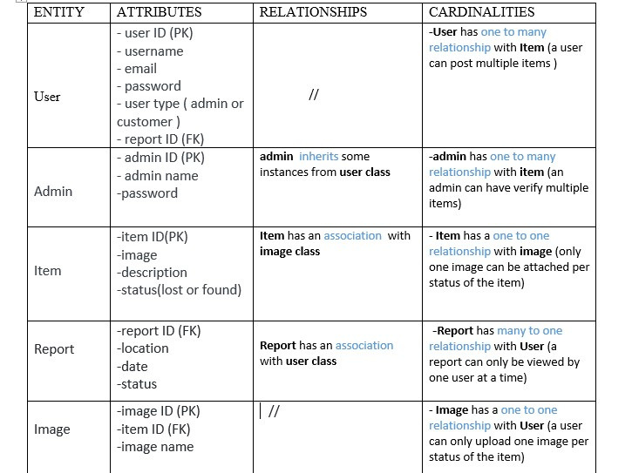
SUMMARY

Slide 7
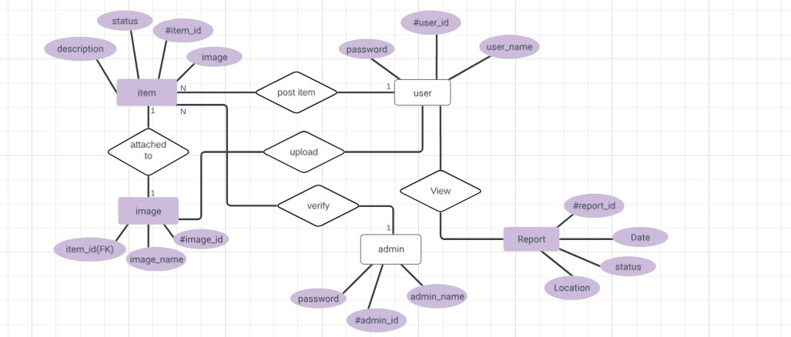
FIGURE REPRESENTING THE ER DIAGRAM OF OUR APP

Slide 8

C. Benefits of using an ER diagram
Provides a clear and organized visual representation of the data structure.
Reduces development time and costs by providing a clear blueprint.
Breaks down complex database structures into manageable components.
Helps in the normalization process by clearly showing how entities are related.
Facilitates effective communication among stakeholders, designers, and developers.

Slide 9
IMPLEMENTATION
a. Logical design with supabase
Supabase is an open-source platform designed to streamline the development of modern web and mobile applications. It provides developers with a robust set of tools and services centered around database management, authentication, serverless functions, and real-time data synchronization. It provides some functions such as
Storage
Metadata Management
Search and Retrieval

Slide 10
b. Why use superbase
I. Extensive authentication and authorization
II. Real time cluster servers
III. Instant API
IV. A postgres database instance, CRUD and authorization workflow

Slide 11
b. Design strategy
I. Relation schema modeling
II. I.Image Processing and Matching
III. Indexing and Optimization
IV. I.Integration with Applications

Slide 12
c. Database Storage
01
02
03
04
USER REGISTRATION INFORMATION
FINDER AND MISSER PERSONAL INFORMATION
UPLOADED IMAGES
MATCHING ALGORITHM

Slide 13

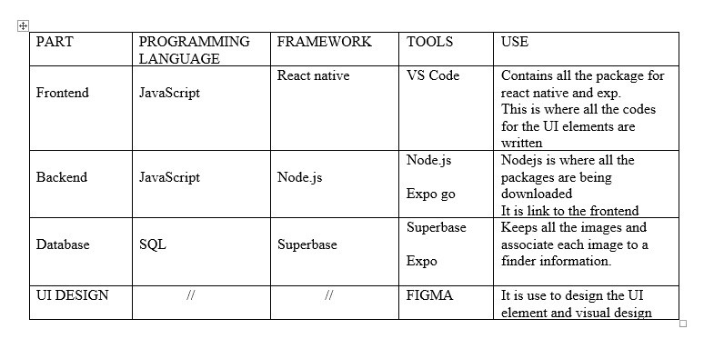

SUMMARY

Slide 14
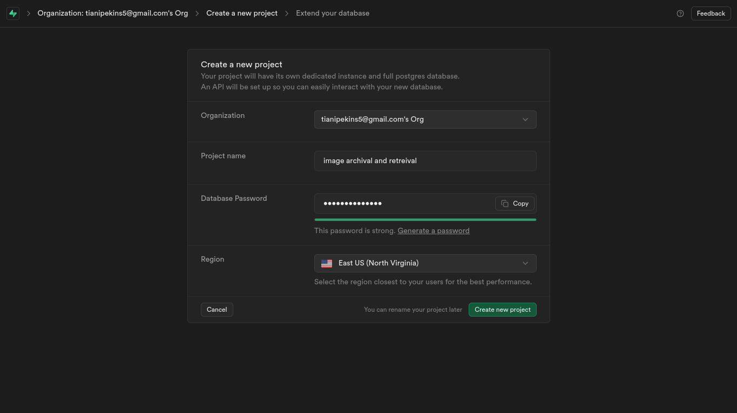
VISUAL REPRESNTATION
CREATING AND CONNECTING THE DATABSE

Slide 15
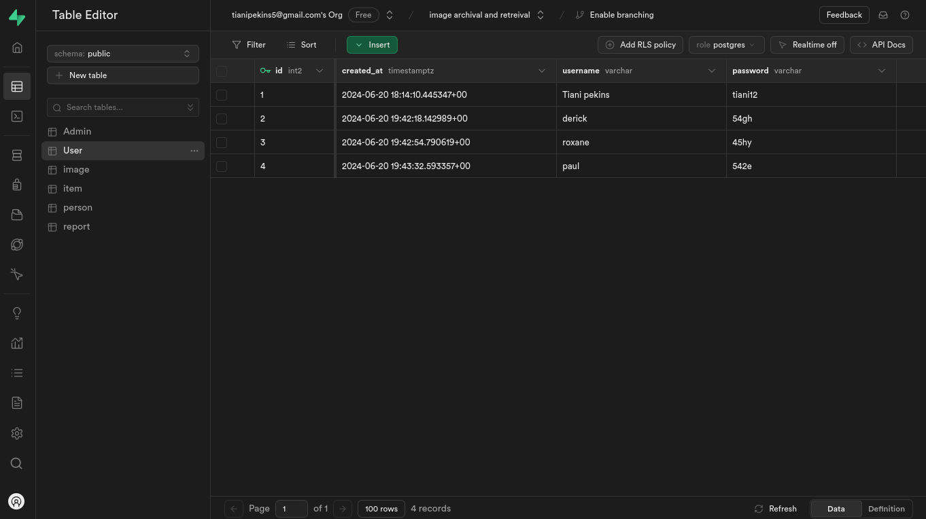
VISUAL REPRESNTATION
POPULATING THE DATABASE

Slide 16

CONCLUSION
in conclusion, database design and implementation are crucial tasks in software development. They involve creating a well-structured database schema to optimize data storage and retrieval. Using a suitable DBMS like PostgreSQL or MySQL ensures effective and secure handling of data

Slide 17




THANK YOU
OFFICE
123 Anywhere St., Any City
+123-456-7890
www.reallygreatsite.com
We look forward to working with you

